Slide 1


Operating System: CA-2
Infrastructure Automation
By D10C: Shrey(59), Ronit(62), Shakti(63), Aaryan(64)

Slide 2
Table of Contents
01
02
03
04
05
06
07
08
Introduction to Infrastructure Automation
Infrastructure as Code (IaC)
Ansible and Terraform Overview
Benefits of Infrastructure Automation
Challenges In Infrastructure Automation
Case Studies of Infrastructure Automation
Best Practices for Successful Automation
Future Trends in
Infrastructure Automation

Slide 3
01
Introduction to Infrastructure Automation
By Shakti

Slide 4
Introduction
Automates and versions infrastructure provisioning and management, enhancing efficiency.
Concept
Originated in the early 2000s with virtualization; evolved through script-based automation and configuration tools.
Evolution
Introduction
Ansible (configuration management) and Terraform (resource orchestration) play crucial roles in IaC adoption.
Key Technologies
Enhances operational efficiency, scalability, and reliability; widely used across industries.
Industry Impact

Slide 5
02
Infrastructure As Code (IaC)
By Shakti

Slide 6
Infrastructure As Code (IaC)
Manual Infrastructure Management (Old Way)
Infrastructure as Code (New Way)
Setting up servers, networks, and configurations manually.
Prone to human errors and inconsistencies.
Time-consuming and difficult to scale.
Uses code to define and manage infrastructure.
Enables automation, scalability, and consistency.
Tools like Terraform, Ansible, and CloudFormation help in provisioning and managing infrastructure efficiently.

Slide 7
03
Ansible and Terraform Overview
By Ronit

Slide 8
Ansible and Terraform Overview
Feature | Ansible | Terraform
Primary Function | Configuration Management | Infrastructure Provisioning
Language | YAML (imperative) | HCL (declarative)
State Management | Stateless | Stateful
Execution Model | Push-based (agentless) | Pull-based (stateful)
Learning Curve | Moderate | Moderate to Steep
What are Ansible & Terraform?
Ansible: Agentless automation tool for configuration management & application deployment.
Terraform: IaC tool for provisioning and managing cloud infrastructure.
How They Work Together?
Terraform provisions infrastructure, Ansible configures it.
Used in DevOps pipelines for end-to-end automation.

Slide 9
04
Benefits of Infrastructure Automation
By Ronit

Slide 10




Benefits of Infrastructure Automation
Cost Reduction
Improved Efficiency & Speed
Cuts operational costs by 35%.
Reduces hardware & energy consumption.
30% faster deployments with automated provisioning.
Eliminates human errors, ensuring consistency.
Resource Optimization
Enhanced Disaster Recovery
40% improved resource utilization in the cloud.
Auto-scales infrastructure based on demand.
50% faster recovery with automated backups.
Version control allows quick rollbacks.

Slide 11
05
Challenges In Infrastructure Automation
By Aaryan

Slide 12
Challenges in Infrastructure Automation
Skills Gap and Personnel Requirements
Need for expertise in scripting & declarative programming (e.g., Ansible, Terraform).
Understanding cloud architectures & distributed systems.
Organizational Change Management
Transition from siloed teams to cross-functional DevOps culture.
Resistance to automation from personnel comfortable with traditional methods.
Security Concerns
Risk of exposing sensitive credentials in code repositories.
Complexity of managing access control for infrastructure-related code.
Integration With Legacy Systems
Compatibility issues between old infrastructure & cloud-native automation tools.
Difficulty in representing existing infrastructure as code.

Slide 13
06
Case Studies of Infrastructure Automation
By Aaryan

Slide 14
Case Studies of Infrastructure Automation
Upgradation of hospital IT Infrastructure
5G Network Deployment Automation
Technologies Used: Ansible & Terraform
Key Achievements:
50% Reduction in System Downtime.
Enhanced Security Posture.
Scalability During Peak Demand.
Impact:
Faster response times for critical hospital operations.
Reduced manual workload for IT teams.
Improved patient care through stable and secure IT infrastructure.
Technologies Used: Ansible & Terraform
Key Achievements:
30% Faster Deployment.
40% Fewer Errors.
Rapid Scaling.
Impact:
Faster network rollout and service availability.
Reduced manual effort for telecom engineers.
Improved reliability and performance of 5G infrastructure.

Slide 15
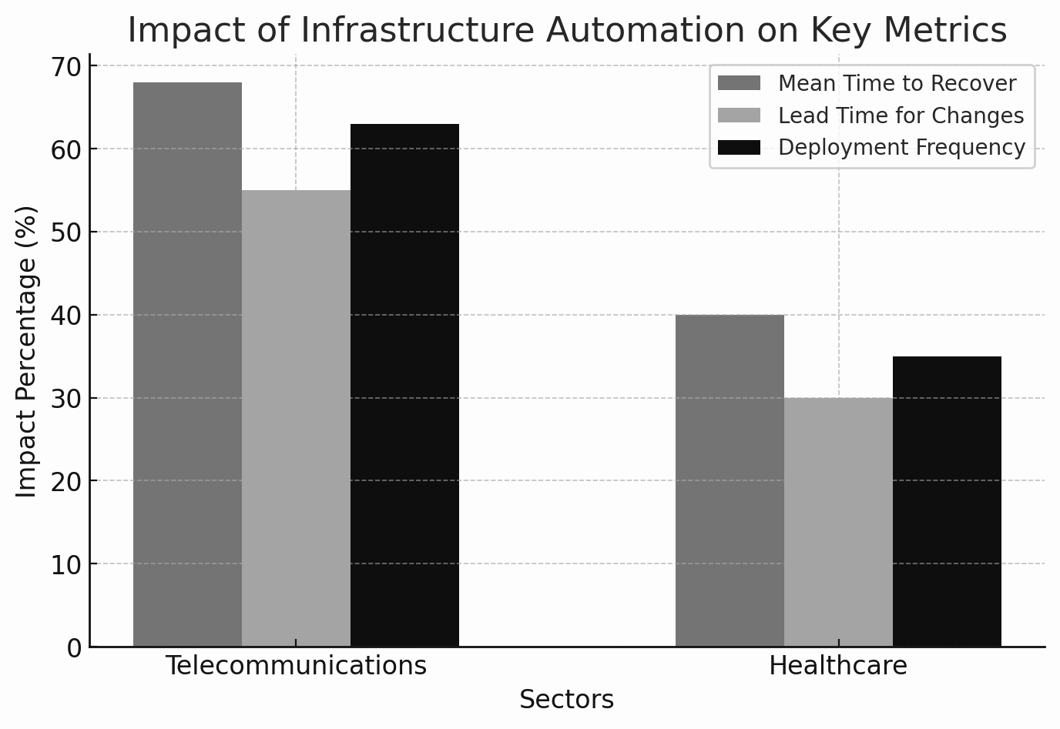

Slide 16
07
Best Practices for Successful Automation
By Shrey

Slide 17
Best Practices for Successful Automation
Track performance, security and use automated alerts.
Regular Monitoring
Manage secret securely and automate access control and audits.
Enhance Security
Practices
Align DevOps, Security, IT teams and encourage knowledge sharing.
Foster Collaboration
Start with small automation projects and continuously improve.
Optimize & Scale

Slide 18
08
Future Trends in Infrastructure Automation
By Shrey

Slide 19
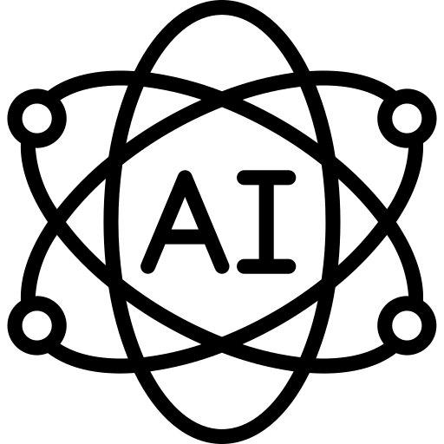



Future Trends in Infrastructure Automation
AI-driven Automation
Serverless & Edge Computing
AI and ML optimize infrastructure management. Predictive scaling and self-heal.
Automating deployments in serverless environments and reducing infrastructure.
Cloud Automation
GitOps & Policy as Code
Seamless provisioning across AWS, Azure and enhanced orchestration tools for cloud agnostic deployments.
Managing infrastructure through Git repositories and automating security & compliance enforcement.

Slide 20
Thank You For Listening!
Any Questions?
Research Paper Name : Automating Infrastructure Management: Benefits and Challenges of Ansible and Terraform Implementation Across Sectors.
Link : https://ijsrcseit.com/index.php/home/article/view/CSEIT241051032

